Slide 1


Team members: LETHIKA.R
MADHUMITHA.A
MUTHU DIVAKAR.M
STAFF:
MR.RENGARAJAN
ASSISTANT PROFESSOR
ELECTRICAL AND ELECTRONICS ENGINEERING
DR.JEEVA KATHIRAVEN, M.TECH,PH.D,
PROFESSOR AND HEAD INFORMATION TECHNOLOGY
PALLIATIVE AUTO NUTRIENT FEED

Slide 2
PROBLEM STATEMENT
Problem Definition
The breathing tube will prevent the patient from eating normally, so a different tube that provides nutrients, may be inserted into their vein. Patients who are on long-term ventilation may require a feeding tube directly inserted into the nose or mouth, or through a hole made in the stomach
Effects of the Problem
The medical team that closely monitors patients on a ventilator includes: doctors, nurses, respiratory therapists, X-ray technicians, and more.
Current Solution
In patients with functional gastrointestinal tract, who cannot or will not eat, enteral feeding is the preferred method. They need someone to feed them and we should regularly monitor them

Slide 3
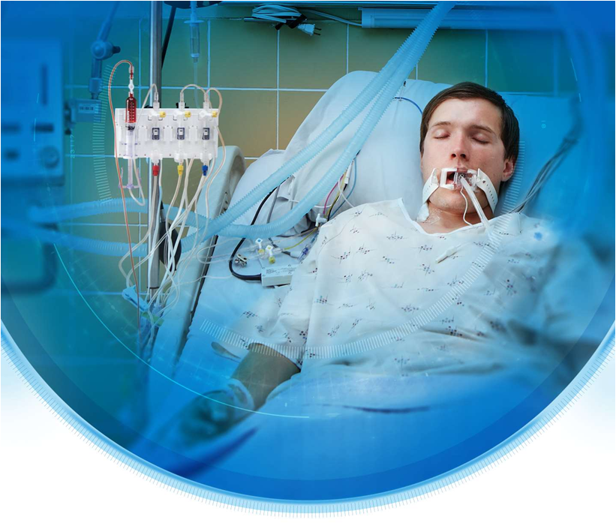
NOVELTY
We are building an auto feed technology to this ICU patients.
We are automating this using IOT
We are monitoring glucose level
Analysing previous existence of food in body
Food existence in the body will be checked and we will automatically able to feed the patients once their stomach is empty.

Slide 4
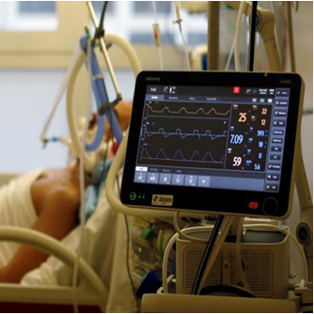
LITERATURE SURVEY
Research works:
https://scholarworks.waldenu.edu/cgi/viewcontent.cgi?article=3454&context=dissertations
https://www.researchgate.net/publication/283076188_Exploring_the_Enteral_Feeding_Practices_Used_by_Critical_Care_Nurses_A_Dissertation
https://research-repository.griffith.edu.au/bitstream/handle/10072/389756/Rattray,%20Megan_Final%20Thesis_redacted.pdf?sequence=4

Slide 5
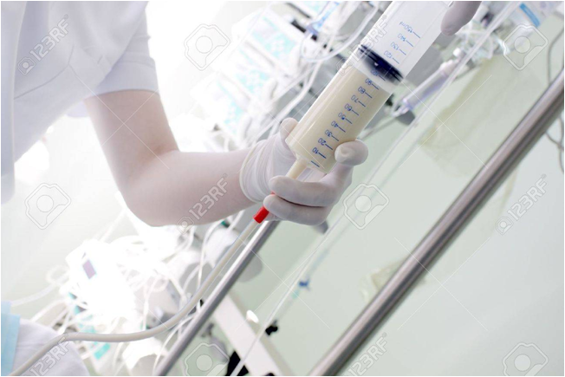
PROPOSED SYSTEM
In this project, we are designing auto palliative feeding technology
In order to check the food level in patient, we check their glucose level in their body
Simultaneously, we check food level using Thermal camera to identify whether they have sufficient in their body or not
If the patient doesn’t have enough amount of food, we automated the feeding using IOT
In the existing system there is no automated nutrient feeding is done
Once in every 15min nurses will go and monitor the patient and will manually set the tube

Slide 6
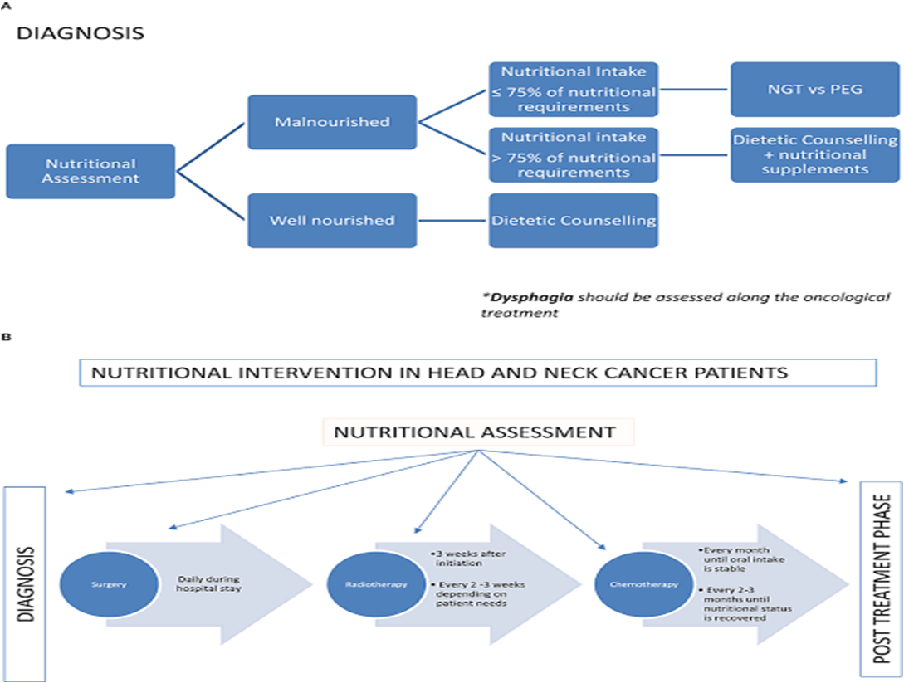
methedlogy:
we are using glucometer and thermal image camera to check the existance of food in patients body
if there is no food in the body using the robotic arm the food will be supplied to the patient

Slide 7
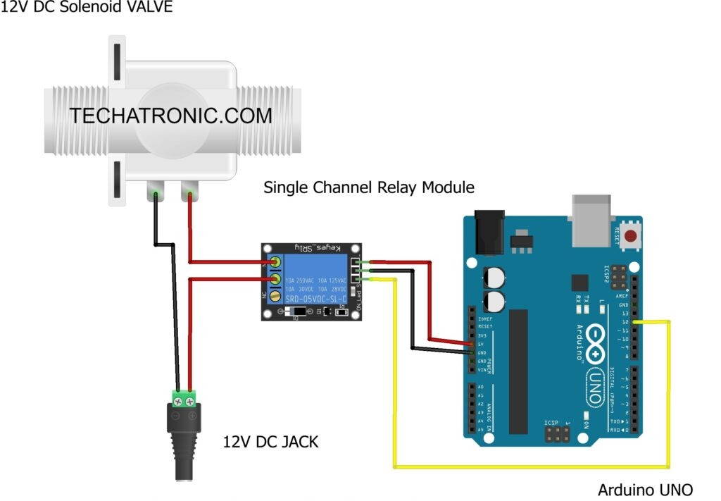
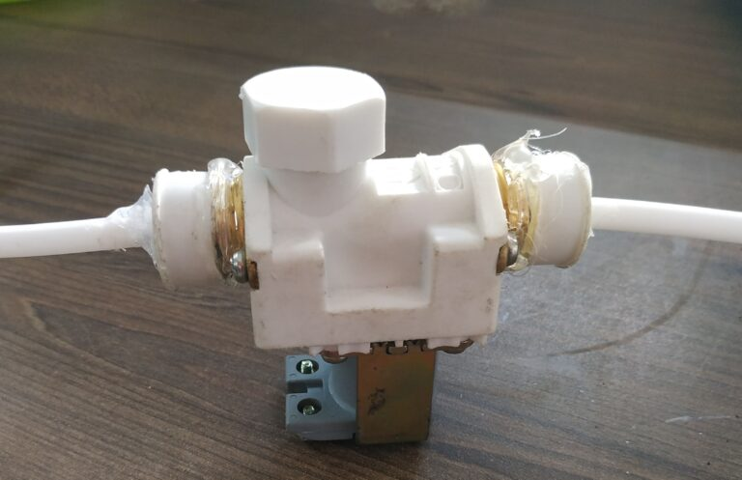
DESIGN

Slide 8
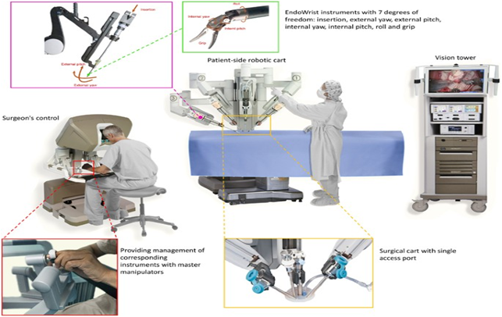
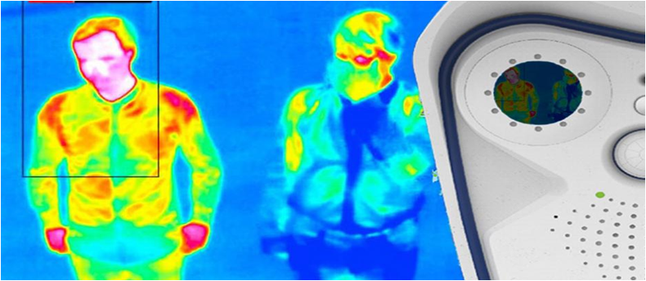
COMPONENTS REQUIRED
Glucometer
Pulse sensor
Raspberry pi
Thermal image camera
Temperature senor

Slide 9
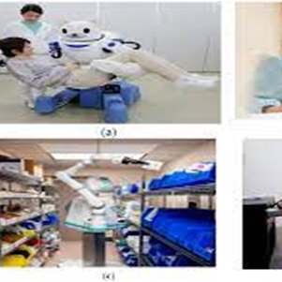
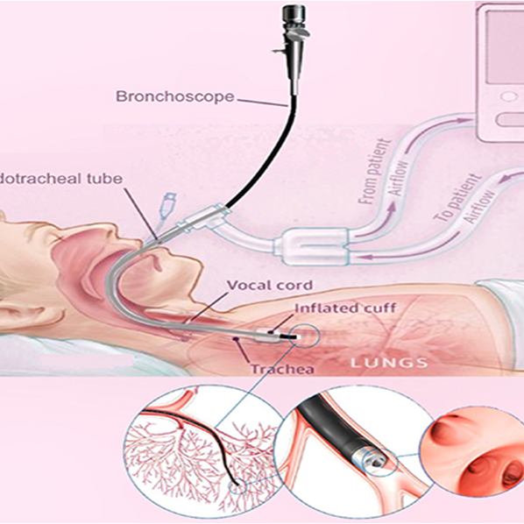
BUDGET
Cost will take around 1.8lak
Glucometer – 12,000
Pressure sensor – 17,000
Raspberry pi – 9,000
Thermal image camera - 70,000
Temperature senor – 2,000
solenoid valve -2,000

Slide 10
COMMERCIALIZATION
We have discussed about this idea to a doctor who is working in a government hospital and they are actually looking for some automation device .
Iin the existing system 30ml of liquid food is set and once in every 15min they should check and refill this
But in this project we are trying to build a automation for this existing problem.
We have talked to few companies to collaborate in future

Slide 11

THANK YOU !

